Slide 1

All Knights Study
John C. Hitt Library Group Finder

Slide 2















Technology used:

Slide 3

Team members and the part they played
Jacob Mayer - - - - - - - - - - - - - - - - - - PM / Front End - Website
Jacob Graff - - - - - - - - - - - - - - - - - - - Front End - Mobile
Chris Parisapogu - - - - - - - - - - - - - - DB
Bryan Aneyro Hernandez - - - - - - - - API
Chase Hanson - - - - - - - - - - - - - - - - Front End - Website
Delali Ekpeh - - - - - - - - - - - - - - - - - - Front End - Mobile
John Vea - - - - - - - - - - - - - - - - - - - - - Front End - Website

Slide 4
Project Manager
Roles:
Organization and communication with the team
Assist with initial planning of app
Help in the areas where help was needed
Keep progress on track
Build presentation
Takeaways:
Leadership
ReactJS
Heroku hosting
Git management

Slide 5
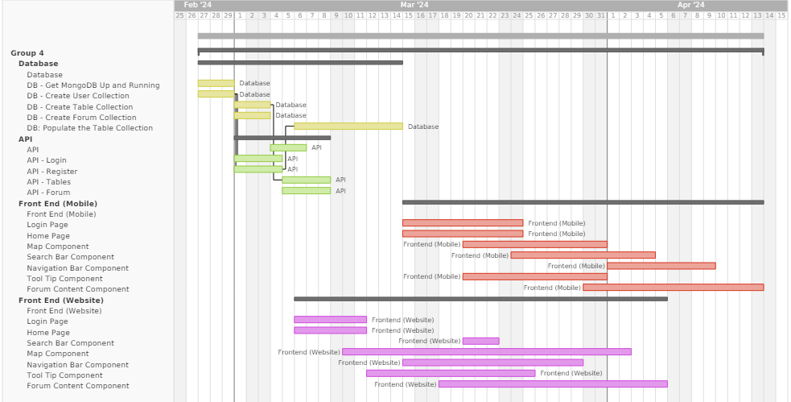
Gantt chart

Slide 6
Database
Roles:
Create maintain the database backend
Determined the best data representation
Assisted API creation
Helped curate the ERD chart accurately
Takeaways:
MongoDB
Mongoose
JSON data structures

Slide 7
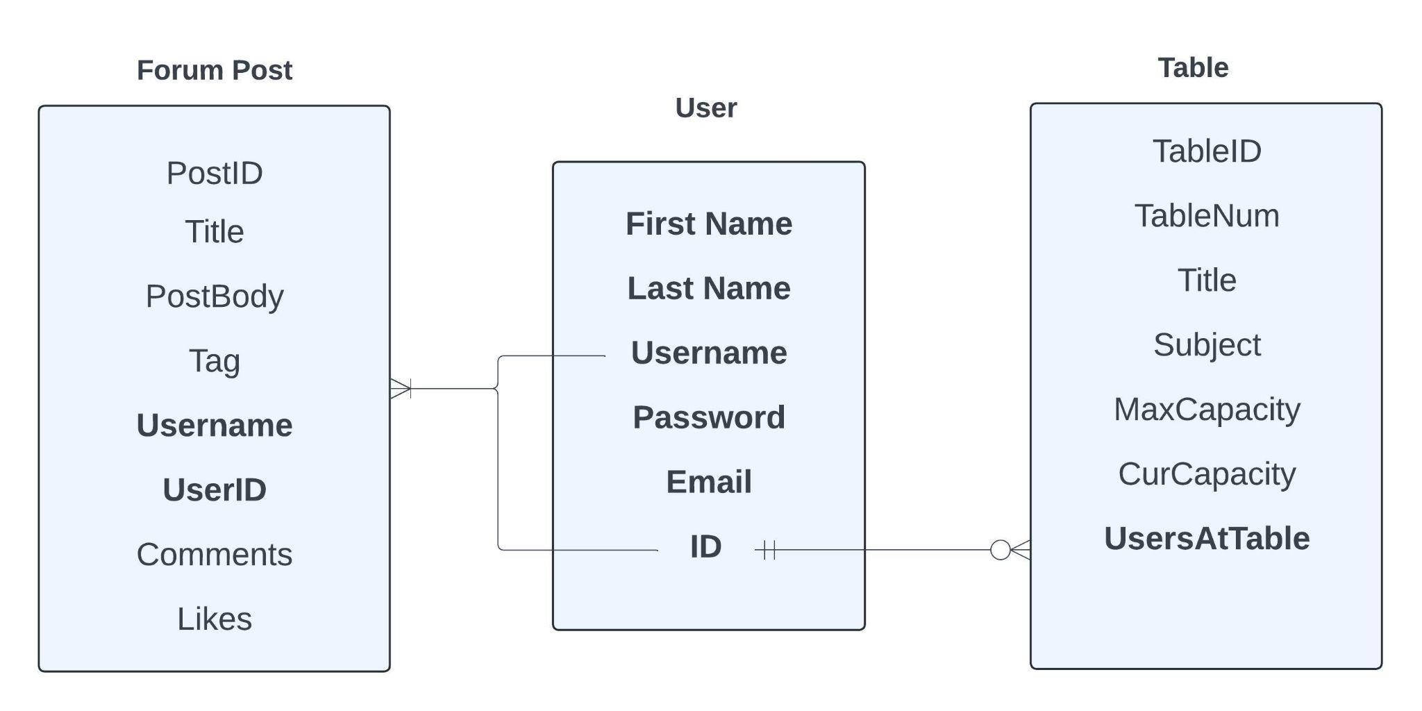
ERD

Slide 8
API
Roles:
Create endpoints to assist front-end tasks
Create various CRUD operation endpoints
Table, Forum, Account
Created API documentation to assist front-end
Tested APIs
Takeaways:
JavaScript
SwaggerHub/Postman
Form verification and verification schema

Slide 9
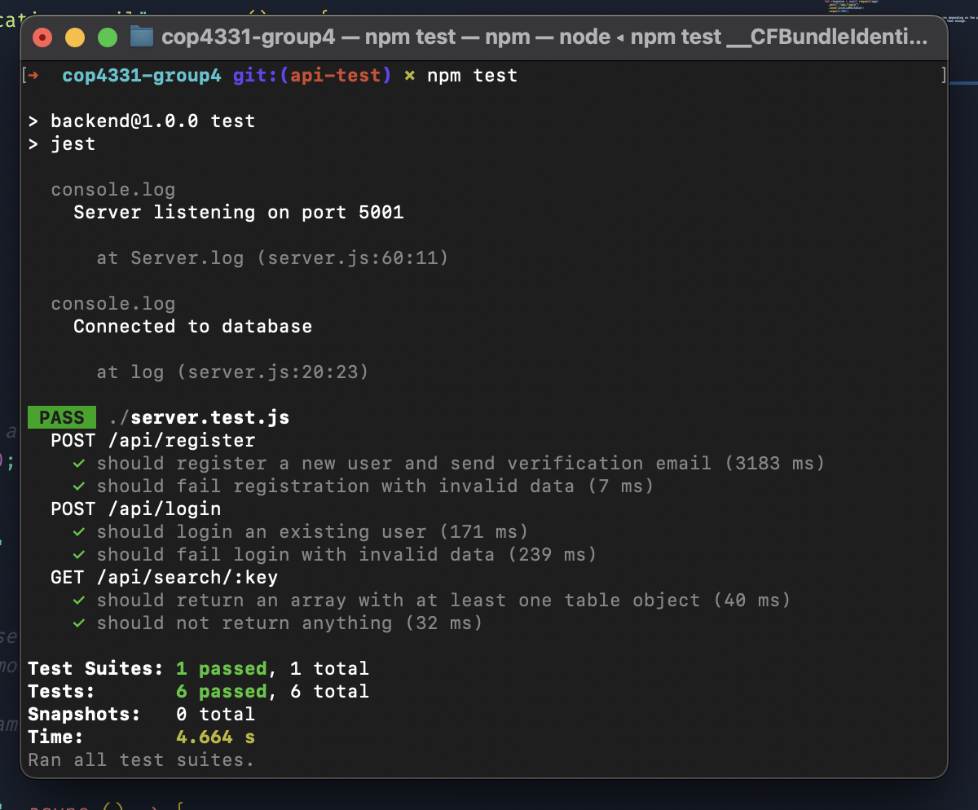
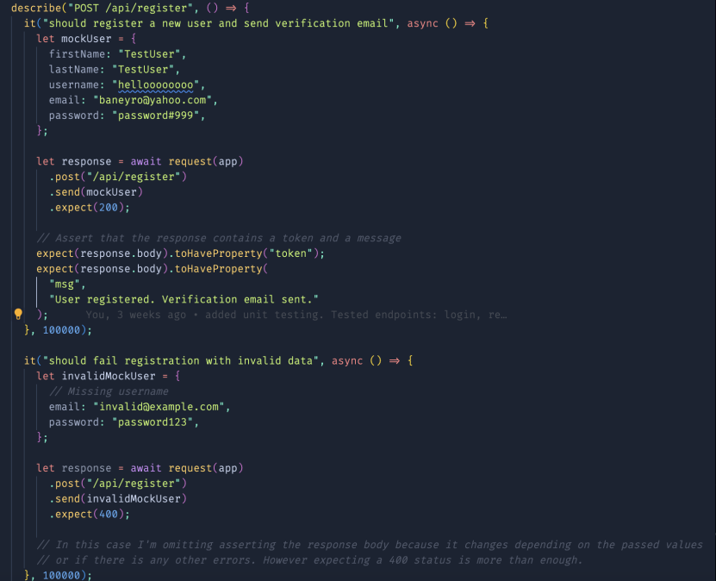
Unit Testing - API

Slide 10
API demonstration
https://app.swaggerhub.com/organizations/BR867228

Slide 11
Front End - Website
Roles:
Connected API enpoints to the functional front end for web access
Established a user friendly environment
Established general styling for the web app
Ensure accessibility for all users
Takeaways:
JavaScript and ReactJS
Tailwind CSS
Usefulness of packages

Slide 12
Front End - Mobile
Roles:
Connected API endpoints to the functional front end for mobile access
Added functionality for mobile accessibility of app functions
Pinch and zoom
Click and drag
Ensured production application on the device worked properly
Takeaways:
Dart and Flutter
Usefulness of packages

Slide 13
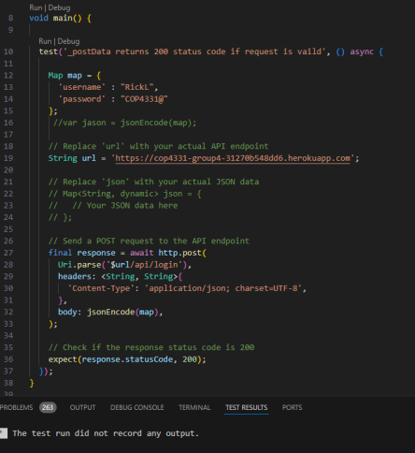
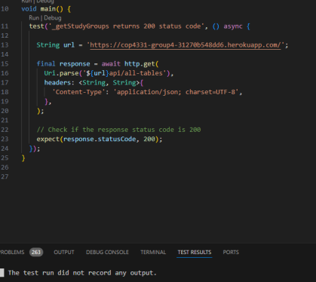
Unit Testing - Mobile

Slide 14
Overview
What went well:
Communication and teamwork
Database and API
Learning ReactJS/Flutter
Forum Functionality
What didn't go well:
NavBar
Debugging of Map Positions
Login/Register Page Design

Slide 15
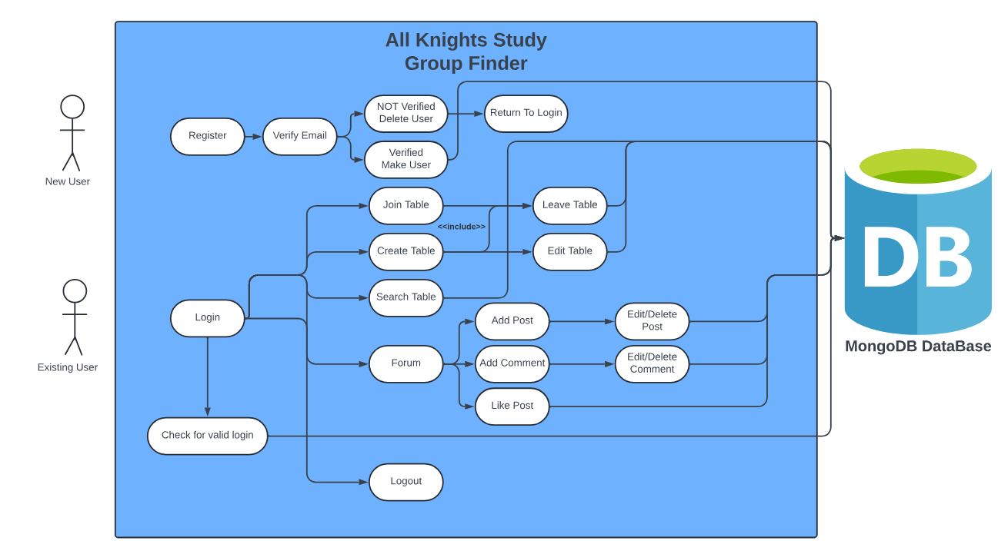
Use Case

Slide 16
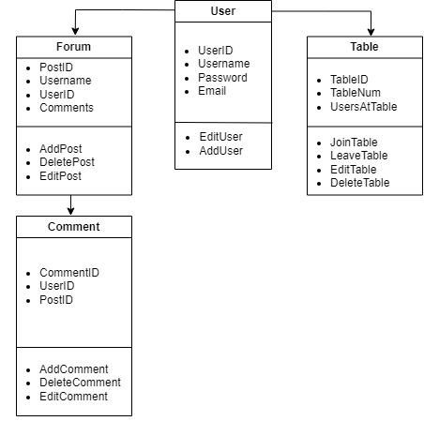
Class Diagram

Slide 17
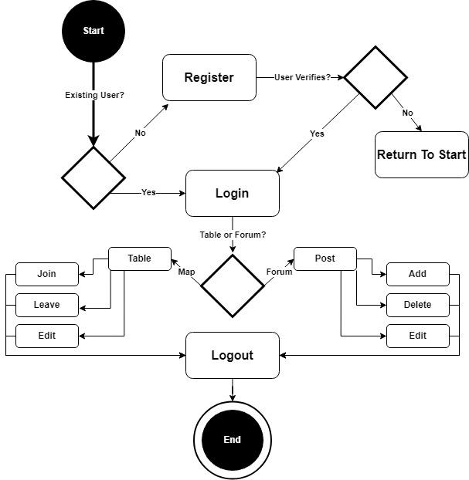
Activity Diagram

Slide 18
App demonstration
https://cop4331-group4-31270b548dd6.herokuapp.com/

Slide 19
Questions?

